Slide 1
E-Commerce analytics using azure services
IST 615 – CLOUD MANAGEMENT
FINAL PROJECT PRESENTATION
Integration blob storage, azure data factory, azure sql studio
Team 9:
M K Sowmeya
Dev Jindani Raaj Mutreja
Sourabh

Slide 2
INTRODUCTION
Our project is a strategic utilization of Azure cloud services—Azure Blob Storage, Azure SQL Database, and Azure Data Factory—to revolutionize customer behavior analysis and prediction.
With a primary focus on enhancing sales strategies for Olist, a leading Brazilian e-commerce platform, we incorporate three key datasets into Azure's dynamic cloud environment. Through meticulous processing and transformation, facilitated by Azure Blob Storage and Azure SQL Database, we prepare the datasets for comprehensive analysis.
The innovation unfolds with the application of Azure Data Studio, enabling the development of analyses that unearth valuable insights into customer behavior.
In summary, our project aims to leverage Azure's cloud services to streamline data processing, create predictive models, and equip Olist with the tools needed to refine its sales strategies for success in the competitive e-commerce landscape.

Slide 3

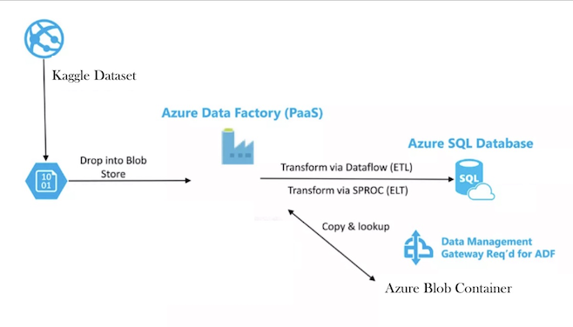
CLOUD SERVICE INTEGRATION WORKFLOW

Slide 4

AZURE BLOB STORAGE
Azure Blob Storage plays a pivotal role in securely storing datasets within the Azure ecosystem, offering a scalable and efficient solution for various types of data.
Efficient Data Ingestion: Azure Blob Storage facilitates efficient data ingestion, streamlining the initial steps in the data processing pipeline.
Staging Area for Data Flow: It acts as a staging area, ensuring smooth data flow before undergoing processing, optimizing the overall pipeline.
Optimal Handling of Unstructured Data: Specialized for handling unstructured data types, providing flexibility for diverse data formats.

Slide 5
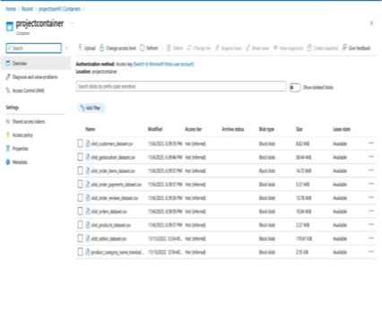
AZURE BLOB STORAGE

Slide 6
AZURE DATA FACTORY IMPLEMENTATION
Azure Data Factory is instrumental in orchestrating data workflows, facilitating the efficient movement and transformation of data within the Azure ecosystem.

Slide 7
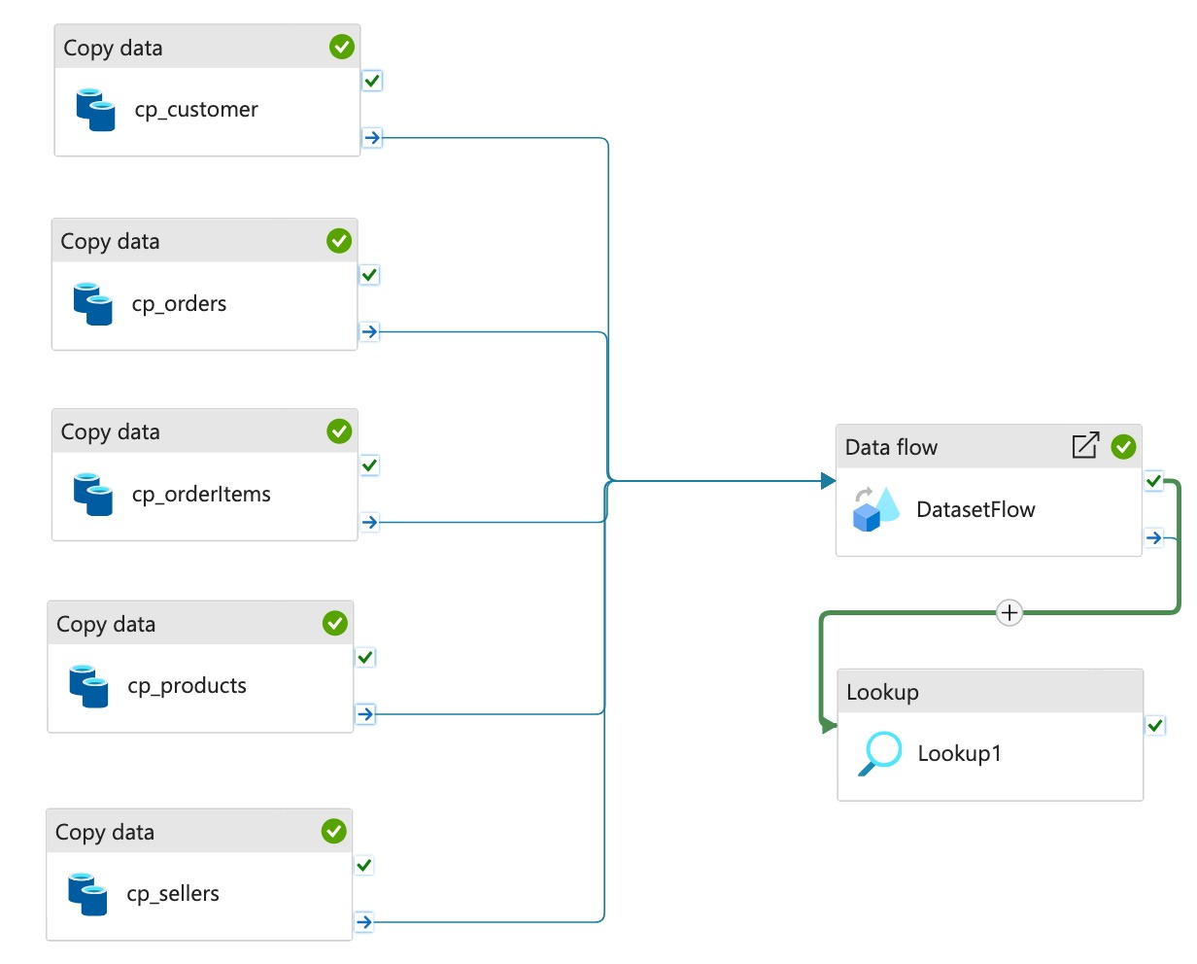
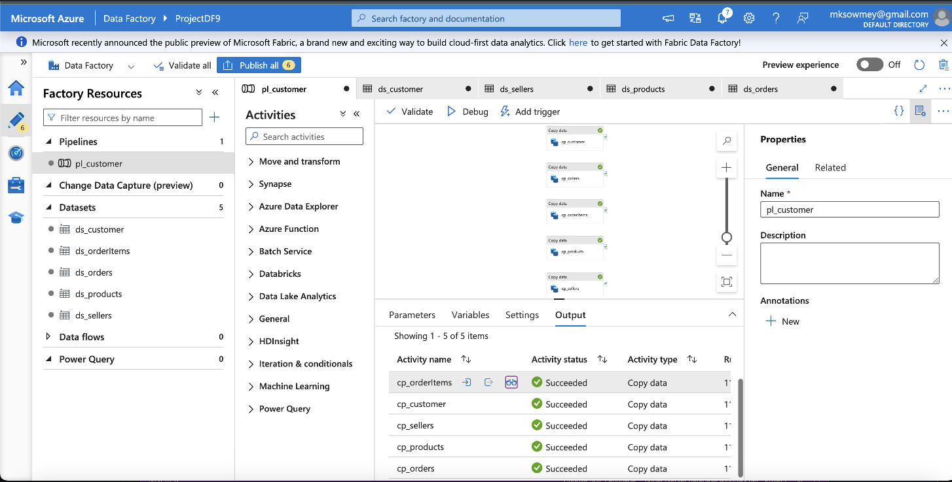
AZURE DATA FACTORY DATASETS & PIPELINES

Slide 8
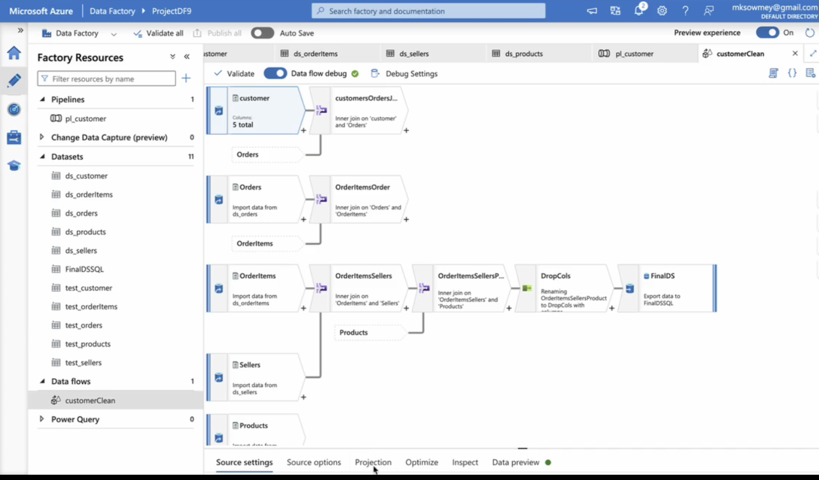
DATA FLOws

Slide 9

Azure SQL Studio Integration
Facilitates seamless data integration from diverse sources, including customer orders, order items, and customer details.
Acts as a fully-managed relational database service for structured and organized data storage.
Ensures optimal query performance, allowing for swift data retrieval during analysis.

Slide 10
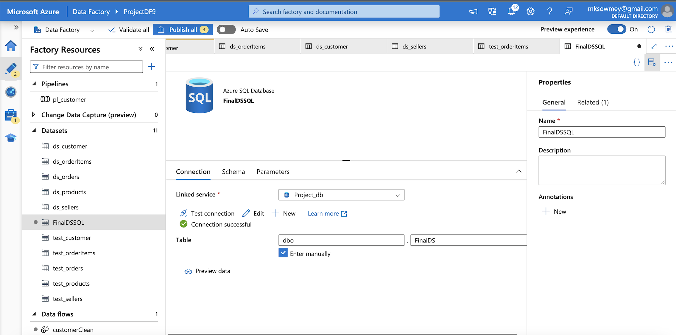
Azure data factory to azure sql studio

Slide 11
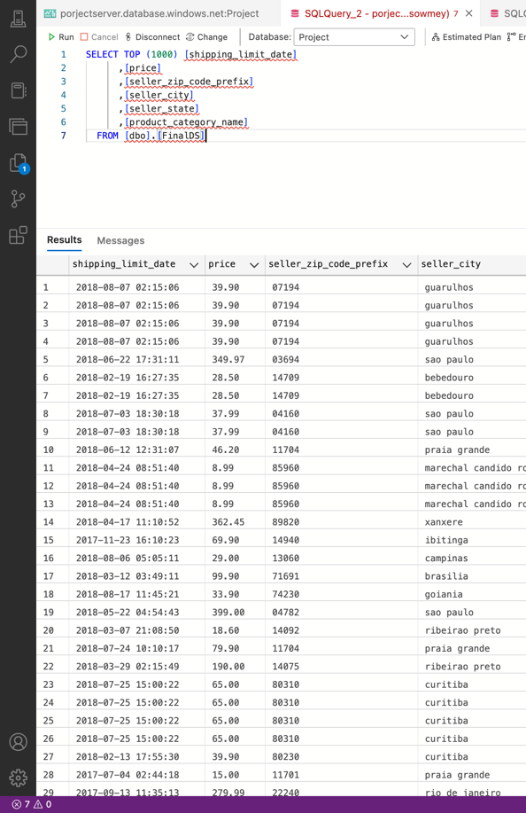
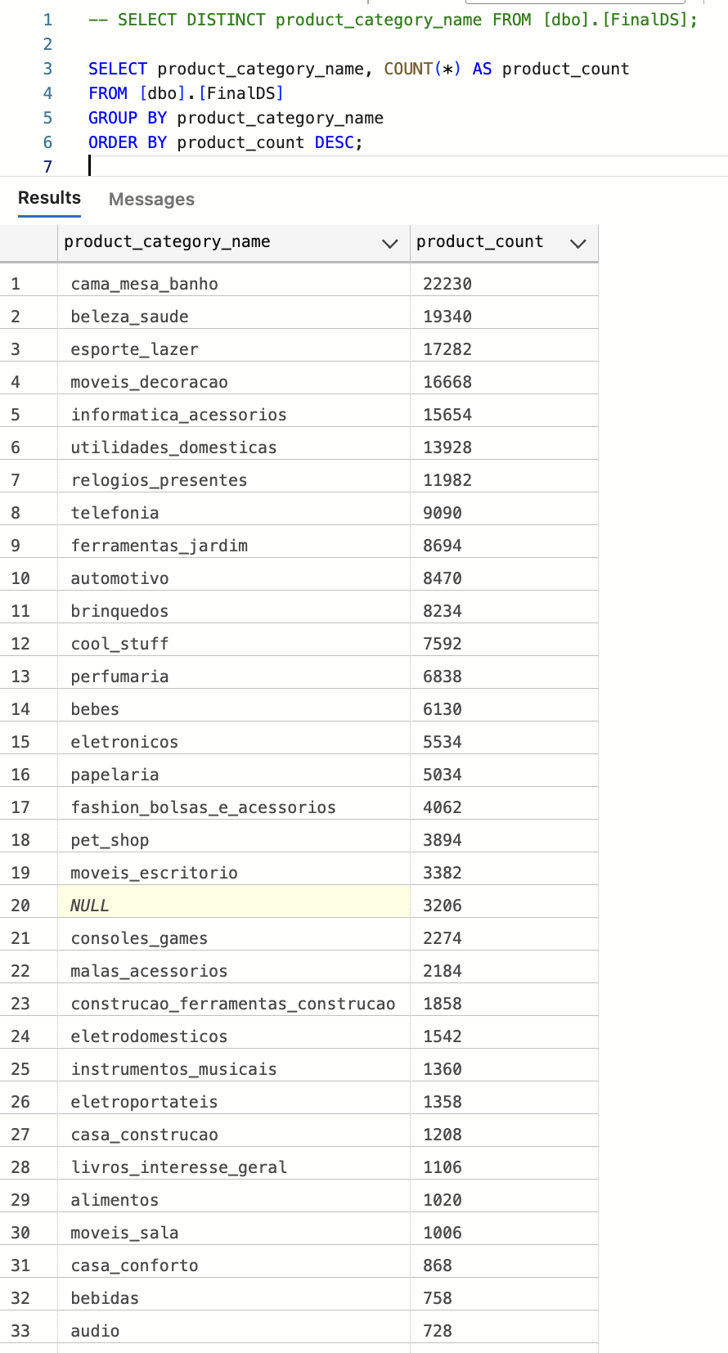
SQL QUERIES

Slide 12
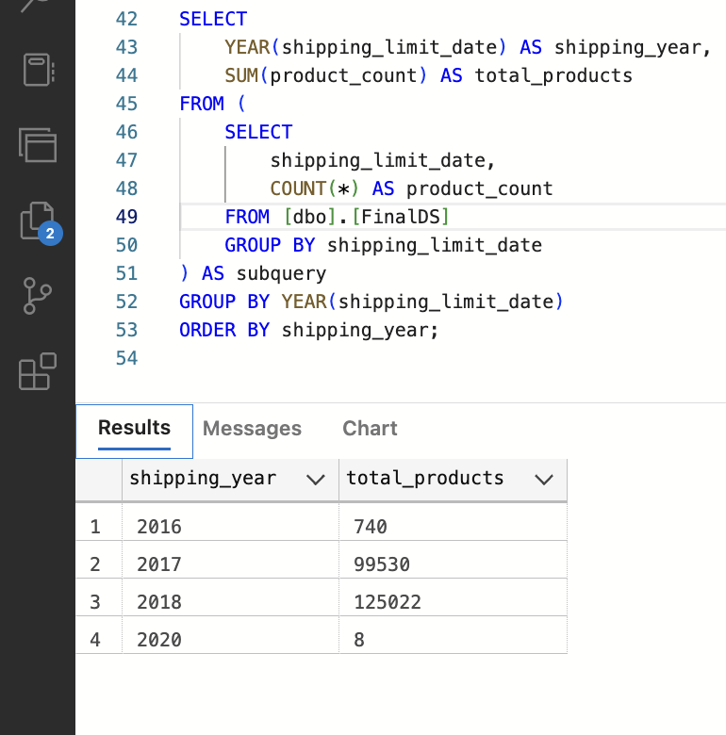
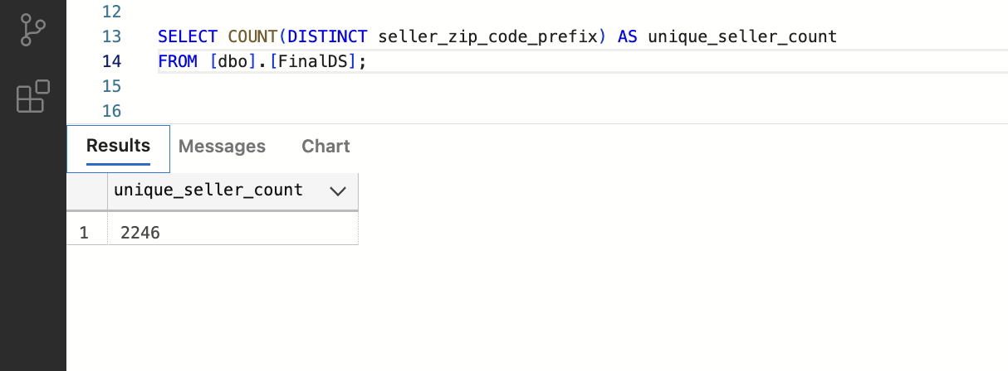
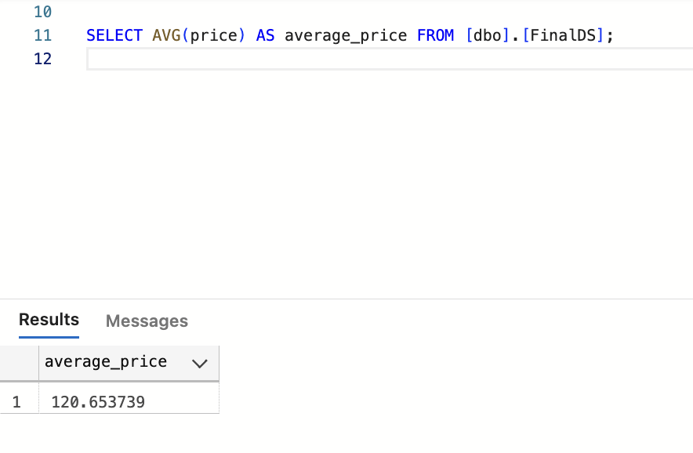
SQL QUERIES

Slide 13
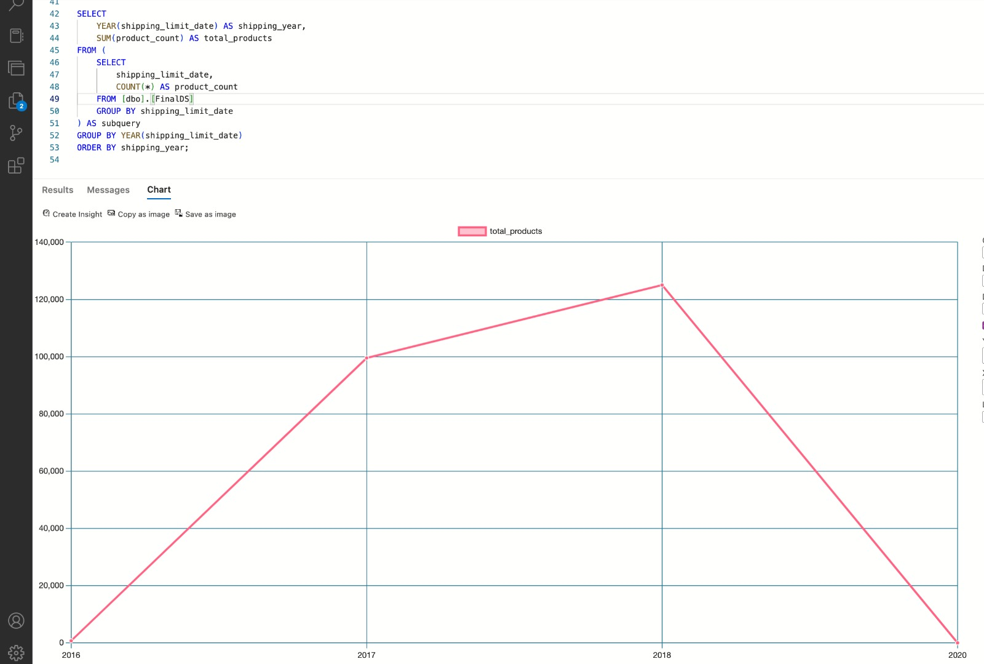
Data Analysis and Visualization in Azure Studio

Slide 14
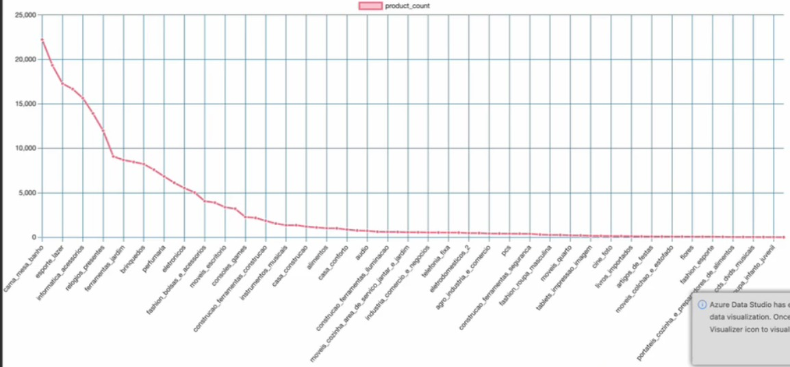
Data Analysis and Visualization in Azure Studio

Slide 15

CHALLENGES FACED
The challenge we faced was with datetime zone in Power Query within Azure Data Factory (ADF) which is a common hurdle when integrating various cloud services. Handling datetime zones, especially in data transformation processes, can be complex due to different time zone formats or inconsistencies across data sources.
In cases where the dataset lacks certain qualities required for predictive modeling, such as insufficient features, data quality issues, or inadequate sample size, predictive modeling might not yield reliable results. When faced with a dataset that isn't suitable for predictive modeling, leveraging SQL queries for analytics purposes becomes a valuable alternative enabling the extraction of insights critical for informed decision-making and strategy formulation.

Slide 16

Conclusion
Strategic Initiative:
Azure services (Blob Storage, SQL Database, Data Factory) revolutionize customer behavior analysis for Olist.
Seamless Integration:
Azure's cloud transforms datasets, laying the foundation for a robust solution.
Azure Blob Storage:
Facilitates efficient data storage and management.
Azure SQL Database:
Ensures reliable integration and retrieval of structured data.
Azure Data Studio:
Innovatively unravels customer behavior trends, providing actionable insights.
Prowess of Azure Ecosystem:
Demonstrates Azure's prowess in practical e-commerce analytics.
Empowering Olist:
Equips Olist with predictive models, optimizing customer engagement and sales strategies.

Slide 17

Thank you

